Slide 1
Arrays
Fixed-Size Sequences of Elements
0
1
2
3
4
…
…
…
…
…
SoftUni Team
Technical Trainers
Software University
http://softuni.bg

Slide 2
Table of Contents
Arrays
Reading Arrays from the Console
Foreach Loop
Multidimensional Arrays*

Slide 3
Have a Question?
sli.do
#tech-csharp

Slide 4
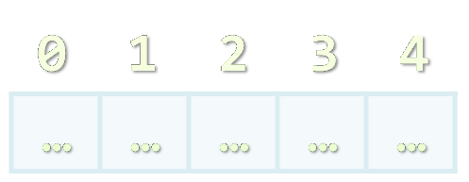
Arrays
Working with Arrays of Elements

Slide 5
What are Arrays?
In programming, an array is a sequence of elements
Elements are numbered from 0 to Length-1
Elements are of the same type (e.g. integers)
Arrays have fixed size (Array.Length) and cannot be resized
0
1
2
3
4
Element index
Array of 5 elements
…
…
…
…
…
Element of an array

Slide 6
Creating Arrays
Use the new keyword
It is used to create the array and initialize the array elements to their default values
Allocating an array of 10 integers:
An array that stores string elements can be declared in the same way:
All elements are initially == 0
int[] numbers = new int[10];
All elements are initially == null
string[] names = new string[10];

Slide 7
Working with Arrays
Assigning values to the array elements
The Length holds the number of array elements
Accessing array elements by index
The [] operator accesses elements by index
for (int i = 0; i < numbers.Length; i++)
numbers[i] = 1;
numbers[5] = numbers[2] + numbers[7];
numbers[10] = 1; // IndexOutOfRangeException

Slide 8
Days of Week – Example
The days of week can be stored in array of strings:
string[] days = {
"Monday",
"Tuesday",
"Wednesday",
"Thursday",
"Friday",
"Saturday",
"Sunday"
};
Operator | Notation in C#
days[0] | Monday
days[1] | Tuesday
days[2] | Wednesday
days[3] | Thursday
days[4] | Friday
days[5] | Saturday
days[6] | Sunday

Slide 9
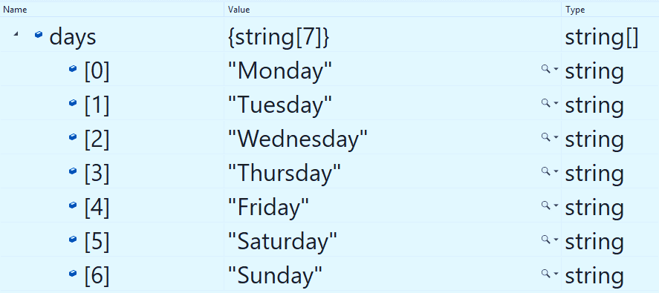
Problem: Day of Week
Enter a day number [1…7] and print the day name (in English) or "Invalid day!"
Check your solution here: https://judge.softuni.bg/Contests/1202/Arrays-Lab

Slide 10
Solution: Day of Week
string[] days = { "Monday", "Tuesday", "Wednesday", "Thursday", "Friday", "Saturday", "Sunday" };
int day = int.Parse(Console.ReadLine());
if (day >= 1 && day <= 7)
Console.WriteLine(days[day - 1]);
else
Console.WriteLine("Invalid day!");
The first day in our array is on index 0, not 1.
Check your solution here: https://judge.softuni.bg/Contests/1202/Arrays-Lab

Slide 11

Reading Array
Using a for Loop or String.Split()

Slide 12
Reading Arrays From the Console
First, read from the console the array length:
Next, create an array of given size n and read its elements:
int n = int.Parse(Console.ReadLine());
int[] arr = new int[n];
for (int i = 0; i < n; i++) {
arr[i] = int.Parse(Console.ReadLine());
}

Slide 13
Reading Array Values from a Single Line
Arrays can be read from a single line of separated values
2 8 30 25 40 72 -2 44 56
Split( ) splits by space into string[]
string values = Console.ReadLine();
string[] items = values.Split();
int[] arr = new int[items.Length];
for (int i = 0; i < items.Length; i++)
arr[i] = int.Parse(items[i]);

Slide 14
Shorter: Reading Array from a Single Line
Read an arrays of integers using functional programming:
using System.LINQ;
var inputLine = Console.ReadLine();
string[] items = inputLine.Split(' ');
int[] arr = items.Select(int.Parse).ToArray();
Or shorter
int[] arr = Console.ReadLine().Split(' ')
.Select(int.Parse).ToArray();

Slide 15
Printing Arrays on the Console
To print all array elements, a for-loop can be used
Separate elements with white space or a new line
string[] arr = {"one", "two"};
// == new string [2] {"one", "two"};
// Process all array elements
for (int index = 0; index < arr.Length; index++) {
// Print each element on a separate line
Console.WriteLine("arr[{0}] = {1}", index, arr[index]);
}

Slide 16
Problem: Print Numbers in Reverse Order
Read an array of integers (n lines of integers), reverse it and print its elements on a single line, space-separated:
4 -1
20
99
5
3
10
20
30
30 20 10
5 99 20 -1
Check your solution here: https://judge.softuni.bg/Contests/1202/Arrays-Lab

Slide 17
Solution: Print Numbers in Reverse Order
// Read the array (n lines of integers)
var n = int.Parse(Console.ReadLine());
var arr = new int[n];
for (int i = 0; i < n; i++)
arr[i] = int.Parse(Console.ReadLine());
// Print the elements from the last to the first
for (int i = n-1; i >= 0; i--)
Console.Write(arr[i] + " ");
Console.WriteLine();
Check your solution here: https://judge.softuni.bg/Contests/1202/Arrays-Lab

Slide 18
Problem: Rounding Numbers
Read an array of real numbers (space separated), round them in "away from 0" style and print the output as in the examples:
0.9 1.5 2.4 2.5 3.14
-5.01 -1.599 -2.5 -1.50 0
0.9 => 1
1.5 => 2
2.4 => 2
2.5 => 3
3.14 => 3
-5.01 => -5
-1.599 => -2
-2.5 => -3
-1.50 => -2
0 => 0
Check your solution here: https://judge.softuni.bg/Contests/1202/Arrays-Lab

Slide 19
Solution: Rounding Numbers
Rounding turns each value to the nearest integer
double[] nums = Console.ReadLine().Split().Select(double.Parse).ToArray();
int[] roundedNums = new int[nums.Length];
for (int i = 0; i < nums.Length; i++) {
roundedNums[i] = (int)Math
.Round(nums[i], MidpointRounding.AwayFromZero);
}
// TODO: Print each number
2.5 => 3
Check your solution here: https://judge.softuni.bg/Contests/1202/Arrays-Lab

Slide 20
Printing Arrays with for / String.Join(…)
Use for-loop:
Use string.Join(separator, array):
int[] arr = { 10, 20, 30, 40, 50};
for (int i = 0; i < arr.Length; i++)
Console.WriteLine(arr[i]);
int[] arr = { 1, 2, 3 };
Console.WriteLine(string.Join(", ", arr)); // 1, 2, 3
string[] strings = { "one", "two" };
Console.WriteLine(string.Join(" - ", strings)); // one - two

Slide 21
Problem: Reverse Array of Strings
Read an array of strings (space separated values), reverse it and print its elements:
Reversing array elements:
a b c d e
e d c b a
-1 hi ho w
w ho hi -1
exchange
a
b
c
d
e
Check your solution here: https://judge.softuni.bg/Contests/1202/Arrays-Lab

Slide 22
Solution: Reverse Array of Strings
var items = Console.ReadLine().Split(' ').ToArray();
for (int i = 0; i < items.Length / 2; i++)
{
var oldElement = items[i];
items[i] = items[items.Length - 1 - i];
items[items.Length - 1 - i] = oldElement;
}
Console.WriteLine(string.Join(" ", items));
Check your solution here: https://judge.softuni.bg/Contests/1202/Arrays-Lab

Slide 23

Foreach Loop
Iterate through Collections

Slide 24
Foreach Loop
Iterates through all elements in a collection
Cannot access the current index
Read-only
foreach (var item in collection)
{
// Process the value here
}

Slide 25
Print an Array with Foreach
int[] numbers = { 1, 2, 3, 4, 5 };
foreach (int number in numbers)
{
Console.Write($"{number} ");
}
1 2 3 4 5

Slide 26

Multidimensional Arrays*
Working with Multidimensional Arrays

Slide 27
What are Multidimensional Arrays?
Multidimensional arrays have more than one dimension
The most used multidimensional arrays are the 2-dimensional, also knowns as matrices
ROWS | COLS
 | [0][0] | [0][1] | [0][2] | [0][3] | [0][4]
 | [1][0] | [1][1] | [1][2] | [1][3] | [1][4]
 | [2][0] | [2][1] | [2][2] | [2][3] | [2][4]
Col Index
Row Index

Slide 28
Creating Multidimensional Arrays
Use the new keyword
Must specify the size of each dimension
This syntax is specific only to C#
int[,] intMatrix = new int[3, 4];
float[,] floatMatrix = new float[8, 2];
string[,,] stringCube = new string[5, 5, 5];

Slide 29
Initializing Multidimensional Arrays
Initializing with values multidimensional array:
Matrices are represented by a list of rows
Rows consist of list of values
The first dimension comes first, the second comes next (inside the first)
int[,] matrix = {
{1, 2, 3, 4}, //row 0 values
{5, 6, 7, 8} //row 1 values
};

Slide 30
Accessing Elements
Accessing N-dimensional array element:
Getting element value:
Setting element value:
nDimensionalArray[index₁, … , index_{n}]
int[,] array = {{1, 2}, {3, 4}}
int element11 = array[1, 1]; //element11 = 4
Returns the length of the dimension
int[,] array = new int[3, 4];
for (int row = 0; row < array.GetLength(0); row++)
for (int col = 0; col < array.GetLength(1); col++)
array[row, col] = row + col;

Slide 31
Printing Matrix – Example
int[,] matrix =
{ { 5, 2, 3, 1 },
{ 1, 9, 2, 4 },
{ 9, 8, 6, 11 } };
for (int row = 0; row < matrix.GetLength(0); row++)
{
for (int col = 0; col < matrix.GetLength(1); col++)
{
Console.Write("{0} ", matrix[row, col]);
}
Console.WriteLine();
}

Slide 32

Printing Matrix – Example (2)
Foreach iterates through all elements in the matrix
int[,] matrix = {
{ 5, 2, 3, 1 },
{ 1, 9, 2, 4 },
{ 9, 8, 6, 9 }
};
foreach (int element in matrix)
{
Console.WriteLine(element);
}

Slide 33

Live Exercises

Slide 34

Summary
…
…
…
Arrays hold a sequence of elements
Elements are numbered from 0 to length-1
Creating (allocating) an array
Accessing array elements by index
Printing array elements
There are arrays with more than one dimension

Slide 35
https://softuni.bg/trainings/courses

Slide 36













SoftUni Diamond Partners

Slide 37




SoftUni Organizational Partners

Slide 38




Trainings @ Software University (SoftUni)
Software University – High-Quality Education and Employment Opportunities
softuni.bg
Software University Foundation
http://softuni.foundation/
Software University @ Facebook
facebook.com/SoftwareUniversity
Software University Forums
forum.softuni.bg

Slide 39

License
This course (slides, examples, demos, videos, homework, etc.) is licensed under the "Creative Commons Attribution-NonCommercial-ShareAlike 4.0 International" license

